Slide 1
Gandiva: Introspective Cluster Scheduling for Deep Learning
Wencong Xiao (Beihang University & Microsoft Research)
Romil Bhardwaj, Ramachandran Ramjee, Muthian Sivathanu, Nipun Kwatra, Zhenhua Han, Pratyush Patel, Xuan Peng, Hanyu Zhao, Quanlu Zhang, Fan Yang, Lidong Zhou
Joint work of MSR Asia and MSR India
Published in OSDI’18

Slide 2
Gandiva: Introspective Cluster Scheduling for Deep Learning
A new scheduler architecture catering to the key characterizations of deep learning training
System innovations bring an order of magnitude efficiency gains

Slide 3
Deep Learning Training vs. Big Data Processing
 | Deep Learning Training | Big Data Processing
Goal | Find a qualified neural model | Compute a set of data
Process | Trial-and-error: see the training accuracy of hyper-parameters a trial job can last for hours or days it might take lots of jobs (~100) May stop a job early if not promising AutoML: automate the process | Run one job to completion may have sub-tasks (e.g., MapReduce) sub-tasks are short-lived (minutes)
Performance | Find the model as fast as possible performance of one job might NOT matter | Run the job as fast as possible
Notes:
Quality model: high accuracy, small footprint
Our goal is to build a system to speed up the process

Slide 4
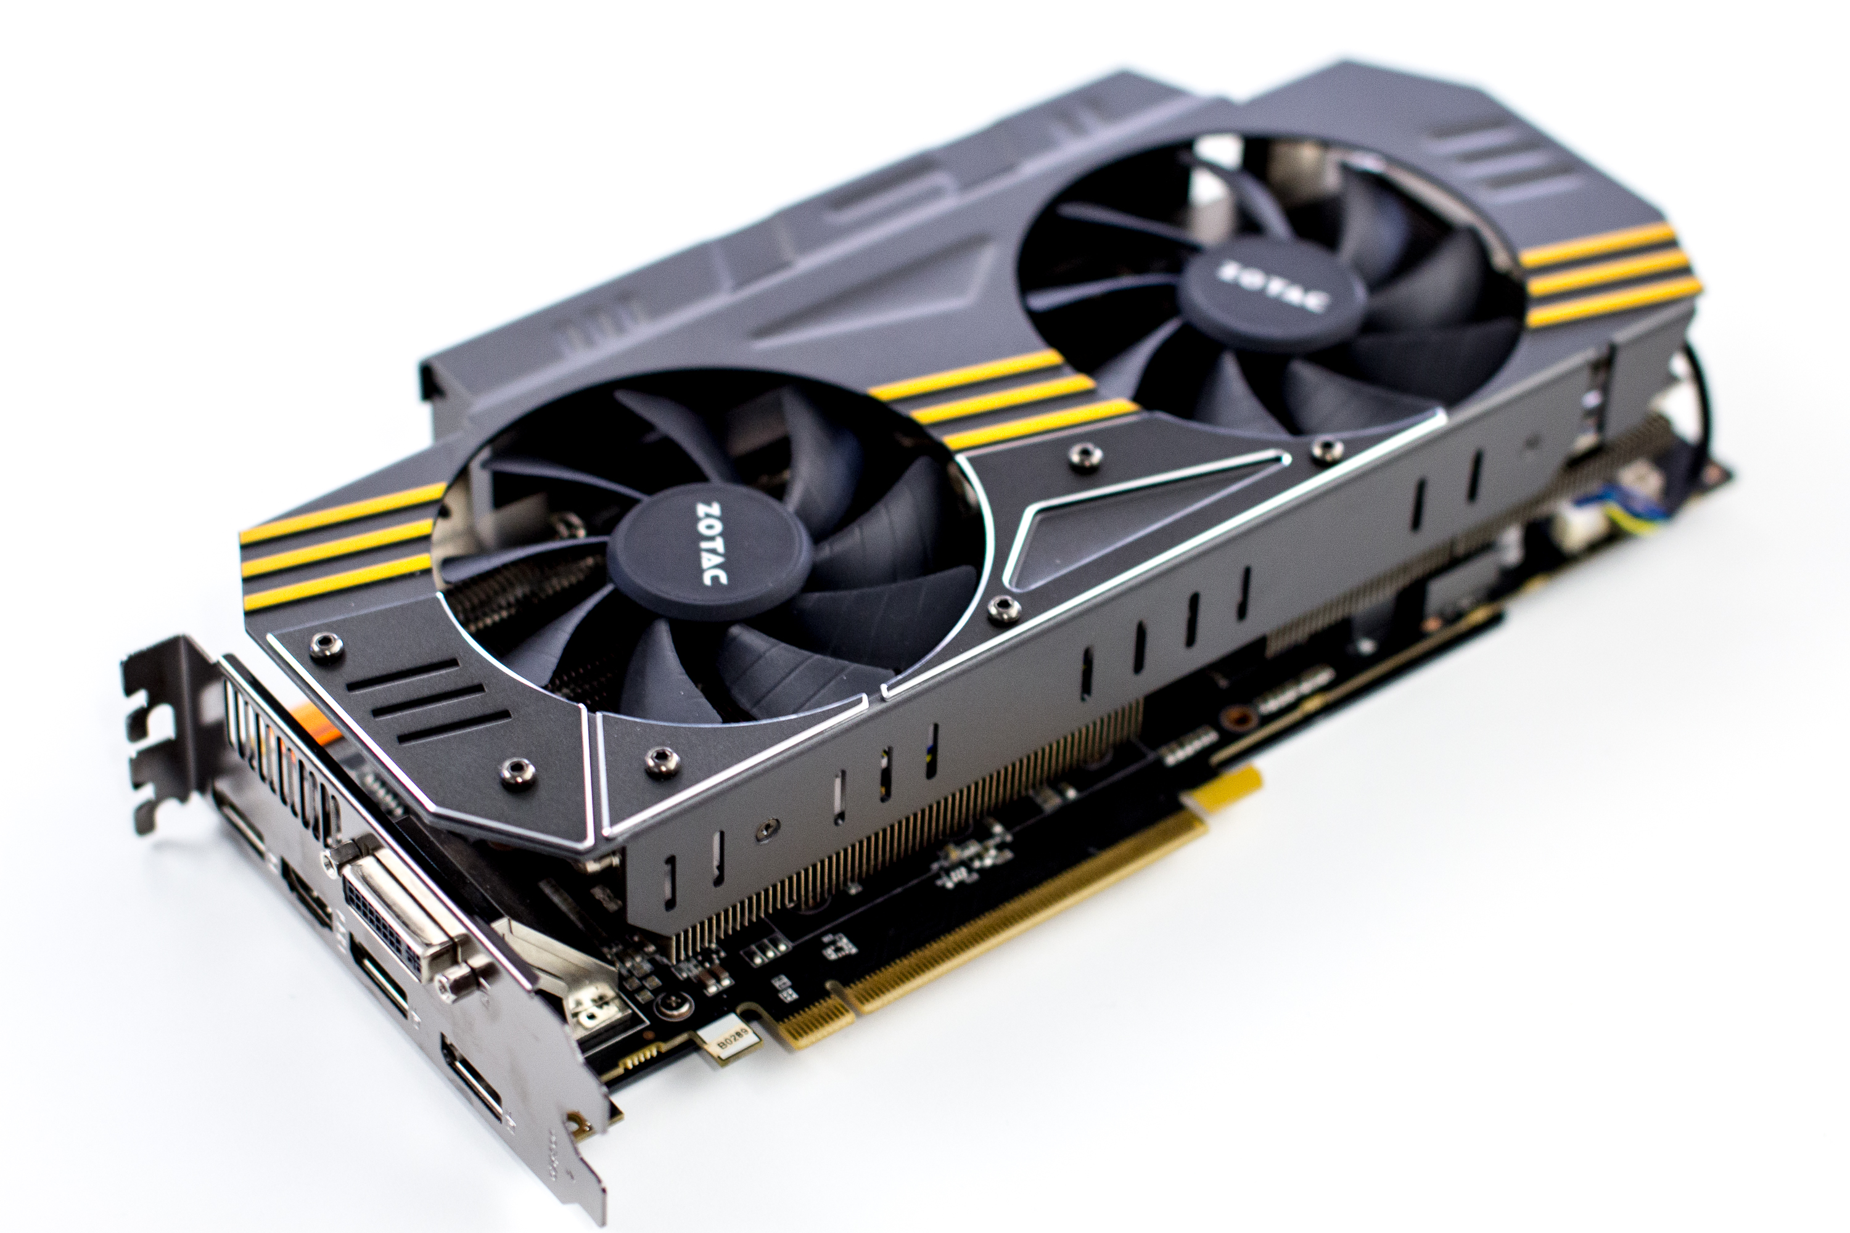
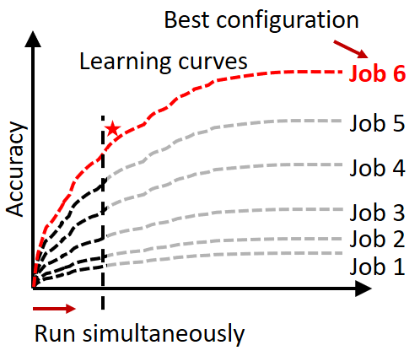

Implication – More Parallel Jobs the Better
Good trial jobs surface earlier
Bad trial jobs stop earlier
More effective search in hyper-parameter space
Need time-slicing of jobs – GPU not efficiently virtualizable
GPU
cluster
Which model is better?
Job1
Job2
Job3
Job4
Job5
Job6

Slide 5
Implication – Long-Running Jobs vs. Changing Environment
Need to adapt the long-running job to the changing environment
Example:
Need ability to migrate jobs
2-GPU Job
Server 1
Server 2

Slide 6
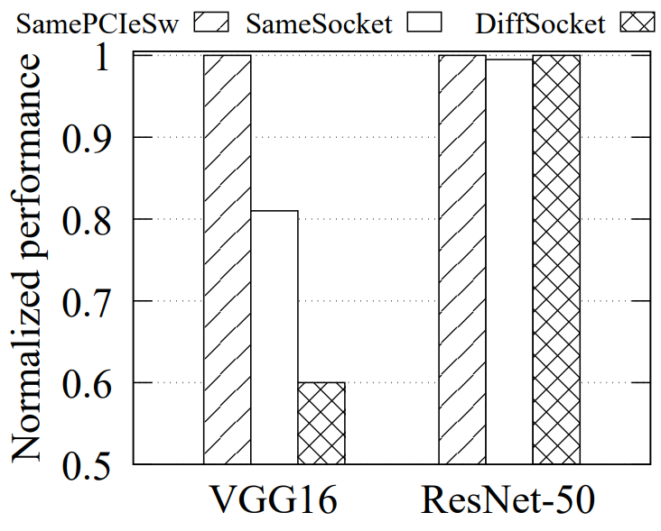
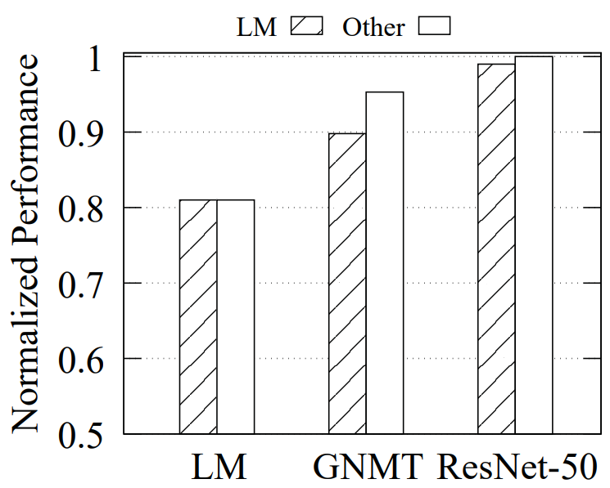
Complication
Sensitivity to locality and interference varies across jobs
How do we know the decision is beneficial?
Notes:
How do we know migration is beneficial?
Better locality but with more interference?

Slide 7
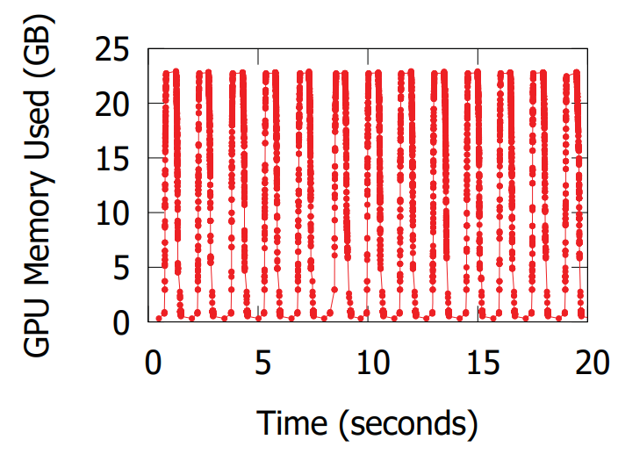
Opportunity – Computation Boundary of Deep Learning
Deep learning training runs in mini-batches
Iterative behavior
Computation divided by super-steps (i.e., mini-batches)
Mini-batches separated by global synchronization
Mini-batch as the computation boundary
Light-weight profiling
Time-slicing and migration at the barrier
ResNet50 on ImageNet data

Slide 8
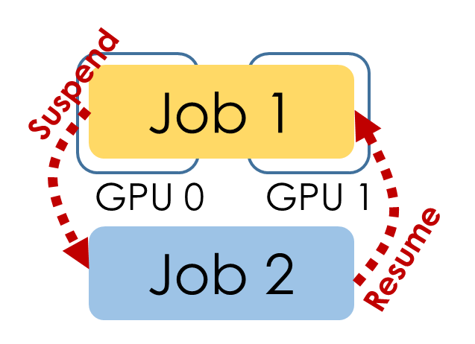
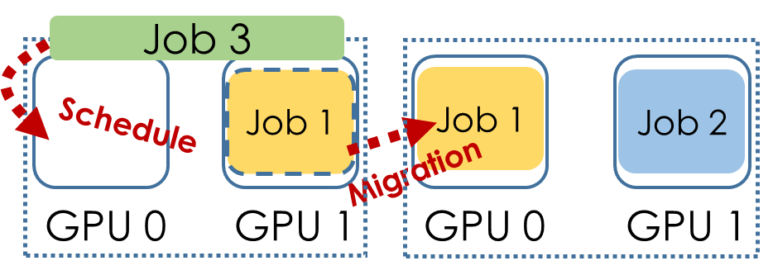
Our approach
Time-slicing and migration as the primitives for scheduling (similar to OS)
Mitigate head-of-line blocking
Explore more trials in parallel
Time-slicing
(50~250ms)
Migration
(~second)

Slide 9
Our approach
Introspection: Application-aware profiling (time-per-minibatch)
Continuous and introspective scheduling to adapt quickly to the changing environment
Efficient implementation by exploiting the predictability
Checkpointing at the mini-batch boundary with minimum memory overhead

Slide 10
A Comparison to Big Data Scheduler
 | Big Data Scheduler | Deep Learning Scheduler
Granularity | MapReduce task or DFG | Mini-batch boundary
Decision | One-time | Continuous/introspective
Profiling | System-level - CPU/GPU Util., disk I/O | Application-level - Time-per-mini-batch

Slide 11
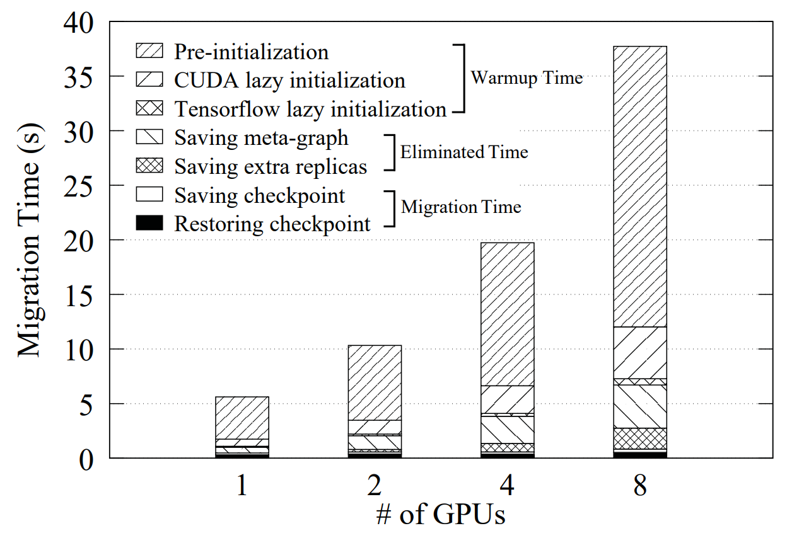
Performance Highlights
Time-slicing
– Less than 2% overhead
Migration
– 50x faster
– <1s migration cost
(including multi-GPU, multi-Node)
ResNet50
Notes:
Migration: save 98% of overhead, sub-second overhead even for multi-GPU, multi-node migration

Slide 12
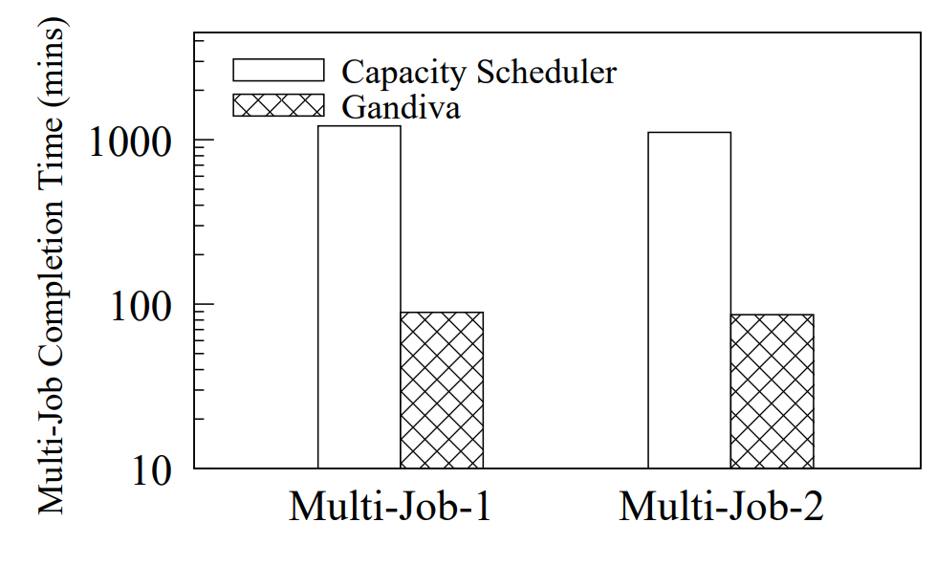
Performance Highlights
AutoML model exploration
– 1.5hrs vs. 20.3hrs
– 13.6X speedup
VGG-like model, >90% accuracy, 40 trials
Two AutoML sessions, each uses 8 GPUs
Background DLT in a 100-GPU cluster

Slide 13




Beyond Research: An Open Source Stack for AI Innovation
OpenPAI platform (2017-December)
Cluster management for AI training and Marketplace for AI asset sharing
NNI – Neural Network Intelligence (2018-September)
A toolkit for automated machine learning experiments
MMdnn (2017-November)
A tool to convert, visualize and diagnose deep neural network models
Tools for AI (2017-September)
An extension to build, test, and deploy deep learning/AI solutions
Notes:
Compiler infrastructure (TBD)
Compile time and runtime optimization

Slide 14
Thank you!

Slide 15


NNI
OpenPAI

